Slide 1


Chip-8 Emulator/Interpreter Dat Nguyen
Notes:
My project is to create an emulator that is capable of running Chip-8 ROMS

Slide 2

Background
Notes:
I’m sure that most of you do not know what Chip-8 is, so let’s talk a little bit about the background

Slide 3
What is Chip-8
Interpreted programming language used in DIY computers in the 1970s
Used in the COSMAC VIP, DREAM 6800, and ETI 660 computers
Make it easier to develop games across different systems
Typical system spec:
8-bit processor
64x32 pixel television display
4KB of RAM
16-key keyboard
Notes:
So, what is Chip-8?
Chip-8 is a simple, interpreted, programming language which was first used on some DIY computer systems in the late 1970s and early 1980s.
It was used in the COSMAC VIP, DREAM 6800, and the ETI 660 computers to name a few.
Its original goal was to create a unified interpreted programming environment to make it easier to develop games across different computer systems
Here is the typical configuration of the Chp-8 computer at the time: 8-bit processor, 64x32 pixel television display, 4KB of RAM, and a 16-key hexadecimal keypad

Slide 4
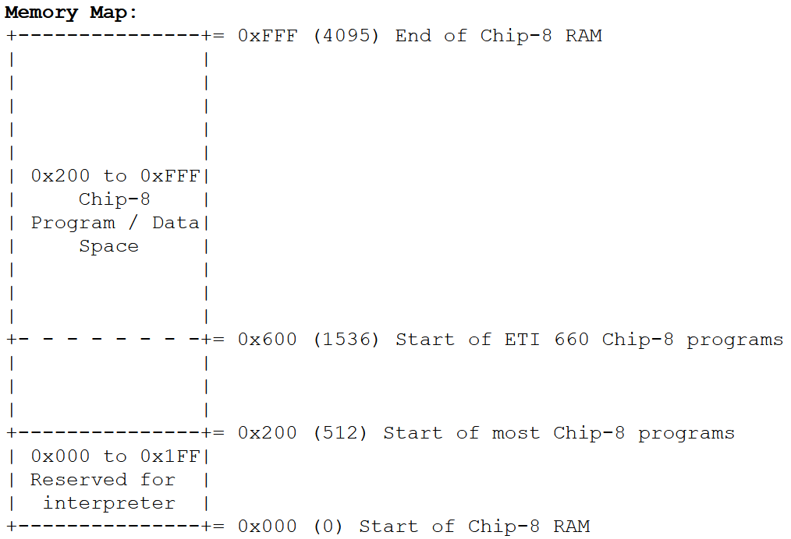
Memory
Addressable memory range [0x000, 0xFFF]
Program-usable addresses start at 0x200
Exception: ETI 660 programs start at 0x600
Notes:
Obviously, since there are 4KB of RAM, the addresses are from 0x000 to 0xFFF
The first 512Bytes are reserved for the original interpreter, so most programs start using RAM at address 0x200, though the ETI 660 programs starts at 0x600

Slide 5
Registers
16 8-bit general-purpose registers (V[x] and V[y])
2 8-bit registers for the timer for the sound
16-bit PC
8-bit stack pointer
Notes:
Chip-8 systems had 16 general purpose registers, usually referred to as V[x] and V[y], where x and y are indexes to the register array
There are also 2 8-bit registers that are used specifically for the sound, a 16-bit program counter, and an 8-bit stack pointer

Slide 6

Implementation
Notes:
Let’s move on to the implementation

Slide 7
Running environment
JavaScript-based emulator that runs Chip-8 ROMs on browsers
Goal: Able to run on all JavaScript-enabled browsers
Notes:
I ran across a web-based Gameboy emulator a couple of months back and thought that it was neat how it was able to run on a resource-limited environment like a browser, so I wanted to do something similar.
The goal is to make it so that the emulator is able to run on all browsers that have JavaScript enabled.

Slide 8
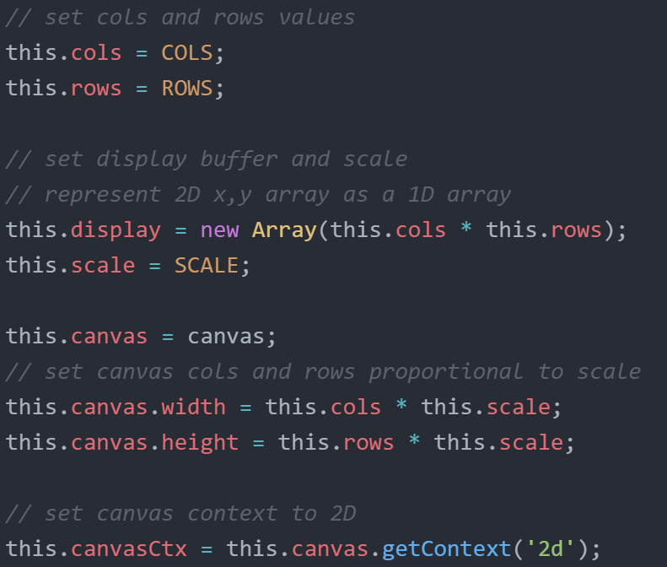
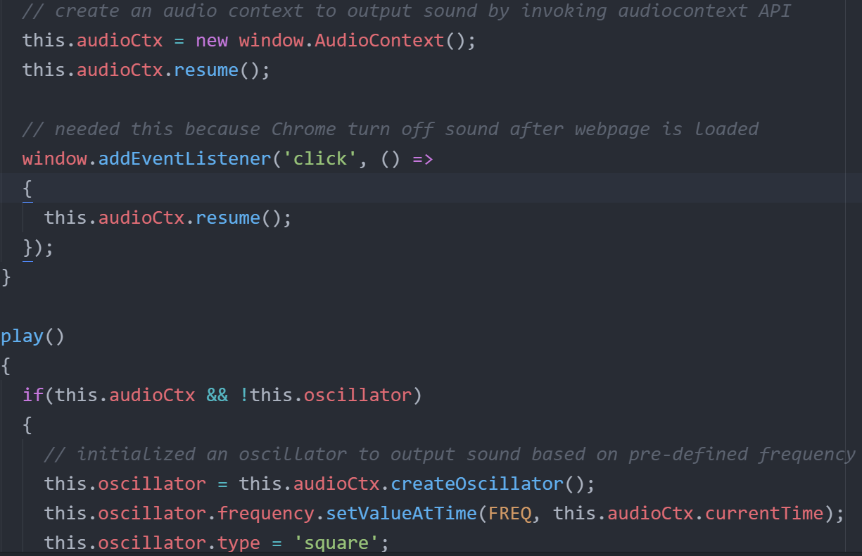
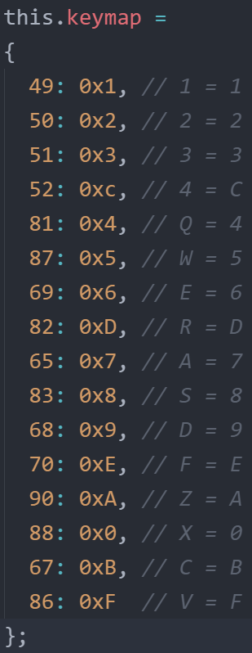
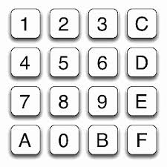
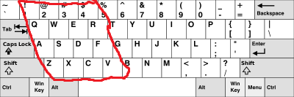
Screen output
Speaker
Notes:
There are 4 main components that I need to account for. The first 3 are relatively simple.
The screen output is handled by the html canvas, which provide a straightforward way to scale the output from 64x32 to a more viewable size
The sound is handled by the JS audioContext API. This is done by setting the oscillator to a certain frequency. Since Chip-8 systems can only output 1 single sound, I just set the frequency to 500Hz
As for the leyboard, they used a weird keyboard layout, so I mapped it like so.

Slide 9
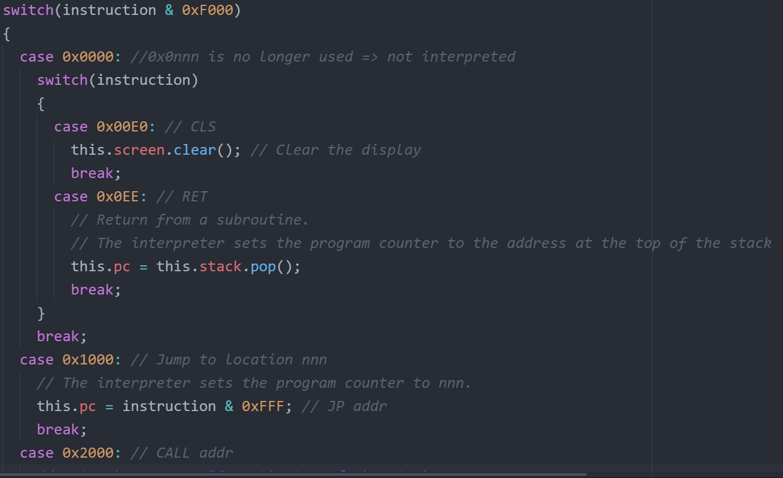
Chip-8 manual: http://devernay.free.fr/hacks/chip8/C8TECH10.HTM
Notes:
Interpreting the OPCODE is the most difficult part of this project, however, thanks to the manual that is available online, the process became much easier. The manual tells you precisely what each OPCODE means and what I should do to service it.
The chip-8 systems are 8-bit systems that can potentially run up to 64K OPCODES. Thankfully, since Chip-8 was designed to develop games, it only has 36 opcodes, 1 of which was never used, so technically 35 OPCODEs.
Most opcodes are relatively short, like the few that are shown on the screen right now, so servicing 36 of them did not take that much time.

Slide 10
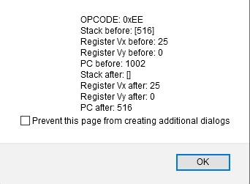
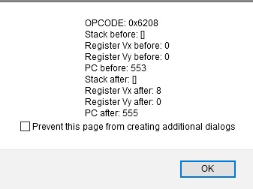
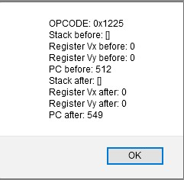
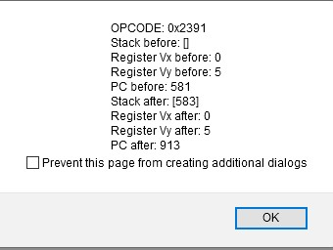
Testing
OPCODE: 0x00EE
Pop the stack and set PC to the popped value
OPCODE: 0x6208
Set V[x] to the value of the least significant Byte of the OPCODE
OPCODE: 0x1225
PC jumps to the address of the last 12 bits of the OPCODE
(0x225 = 549)
OPCODE: 0x2391
Push the next PC onto the stack and set PC to last 12 bits of the OPCODE
(0x391 = 913)
Notes:
Testing is the thing that took the longest. I don’t know an effective way to test if the OPCODEs are interpreted correctly, so I just printed them out one by one as the program run using alert. On the screens are some of the examples. I went one by one a marked them off. Some of the OPCODEs are not tested this way, like the keyboard inputs and the sound. They are just tested by playing the ROMs.
Notice that the program counter is incremented by 2 each time. This is because each OPCODE is 16-bit, which is 2 bytes

Slide 11

Demo

